Slide 2
We are the student organisation for the Palacky English medical and dental programmes

Slide 3
PRESIDENT
VICE-PRESIDENT
TREASURER
PUBLIC RELATIONS

Slide 4
SOCIETIES REP
EDUCATION REP
STUDENT SUPPORT LIASION
SPORTS REP

Slide 5
MED REP - LOWER
DENT REP - LOWER
DENT REP - UPPER
MED REP- UPPER

Slide 6
1) Social Media
2) Whatsapp, direct messages
3) Email: kameron321@yahoo.com

Slide 7
Problems with exam dates
Social events
Student support
General Advice – Revision plans, home/social problems, ANYTHING!
Healthcare at Nej
- Male: Kameron
Female: Mayuri and Magdalin
Can’t help with: visa, residency, insurance questions – Ms Jana Osmani

Slide 8
We will be putting up posts on social media with recommendations
Globus (Nej), Billa (Uni + centrum), Albert (Uni + centrum + Santovka) , Lidl (Nej – there are others….. My preference).
Santovka
Centrum – pubs (lunch menus), Indian, Sushi, Burgers, Pizza
Delivery services- Damejidlo, Wolt (webistes and apps available)
Menzas – Food Credit via Portal (Hearty, Cheap, Preorder)

Slide 9
TRAVEL!

Slide 10
Easy to travel to nearby cities via coaches and trains
Regiojet- ISIC discount
Ceske Drahy- ISIC discount

Slide 11
APPS
UPOL App (Schedule + Exams sign up)
PUBTRAN/IDOS
GOOGLE TRANSLATE
BOLT
GT TAXI APP
LIDL PLUS
WOLT/DAMEJIDLO
REGIOJET/Muj VLAK (Ceske Drahy)

Slide 13
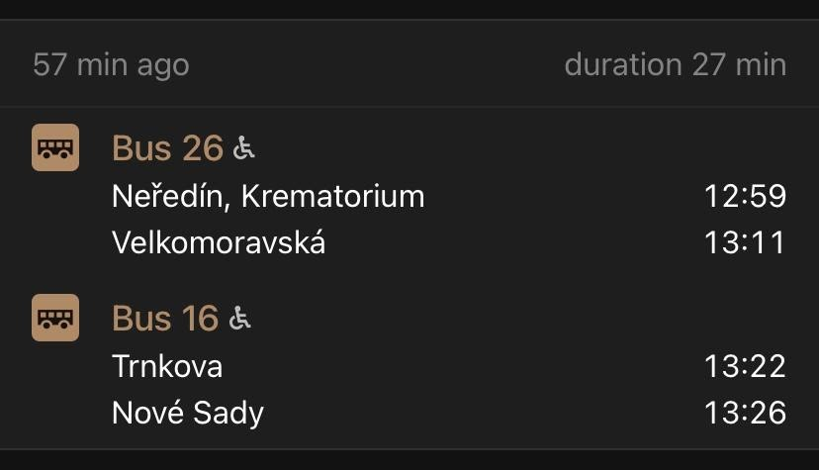
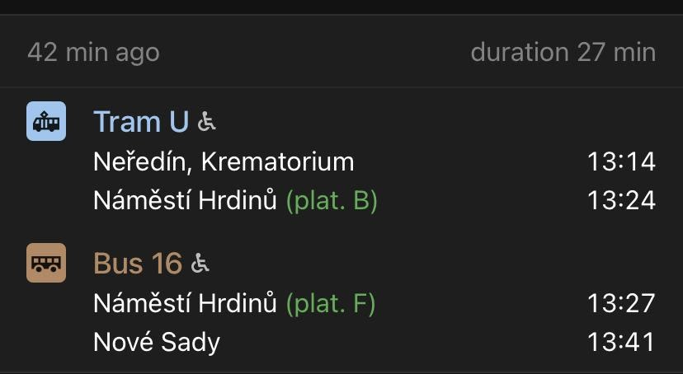
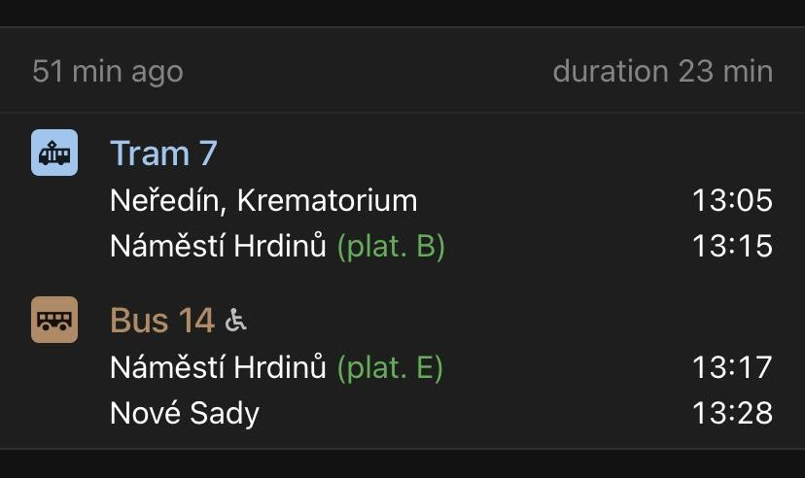
Booking football pitches at Nove Sady
—> David: +420 724 710731
Price: 600kc for 2hrs
Nove Sady - Pitches
11-a-side Team –
English programme
League —> Mid October
Tournament –> Summer
UIMS

Slide 14
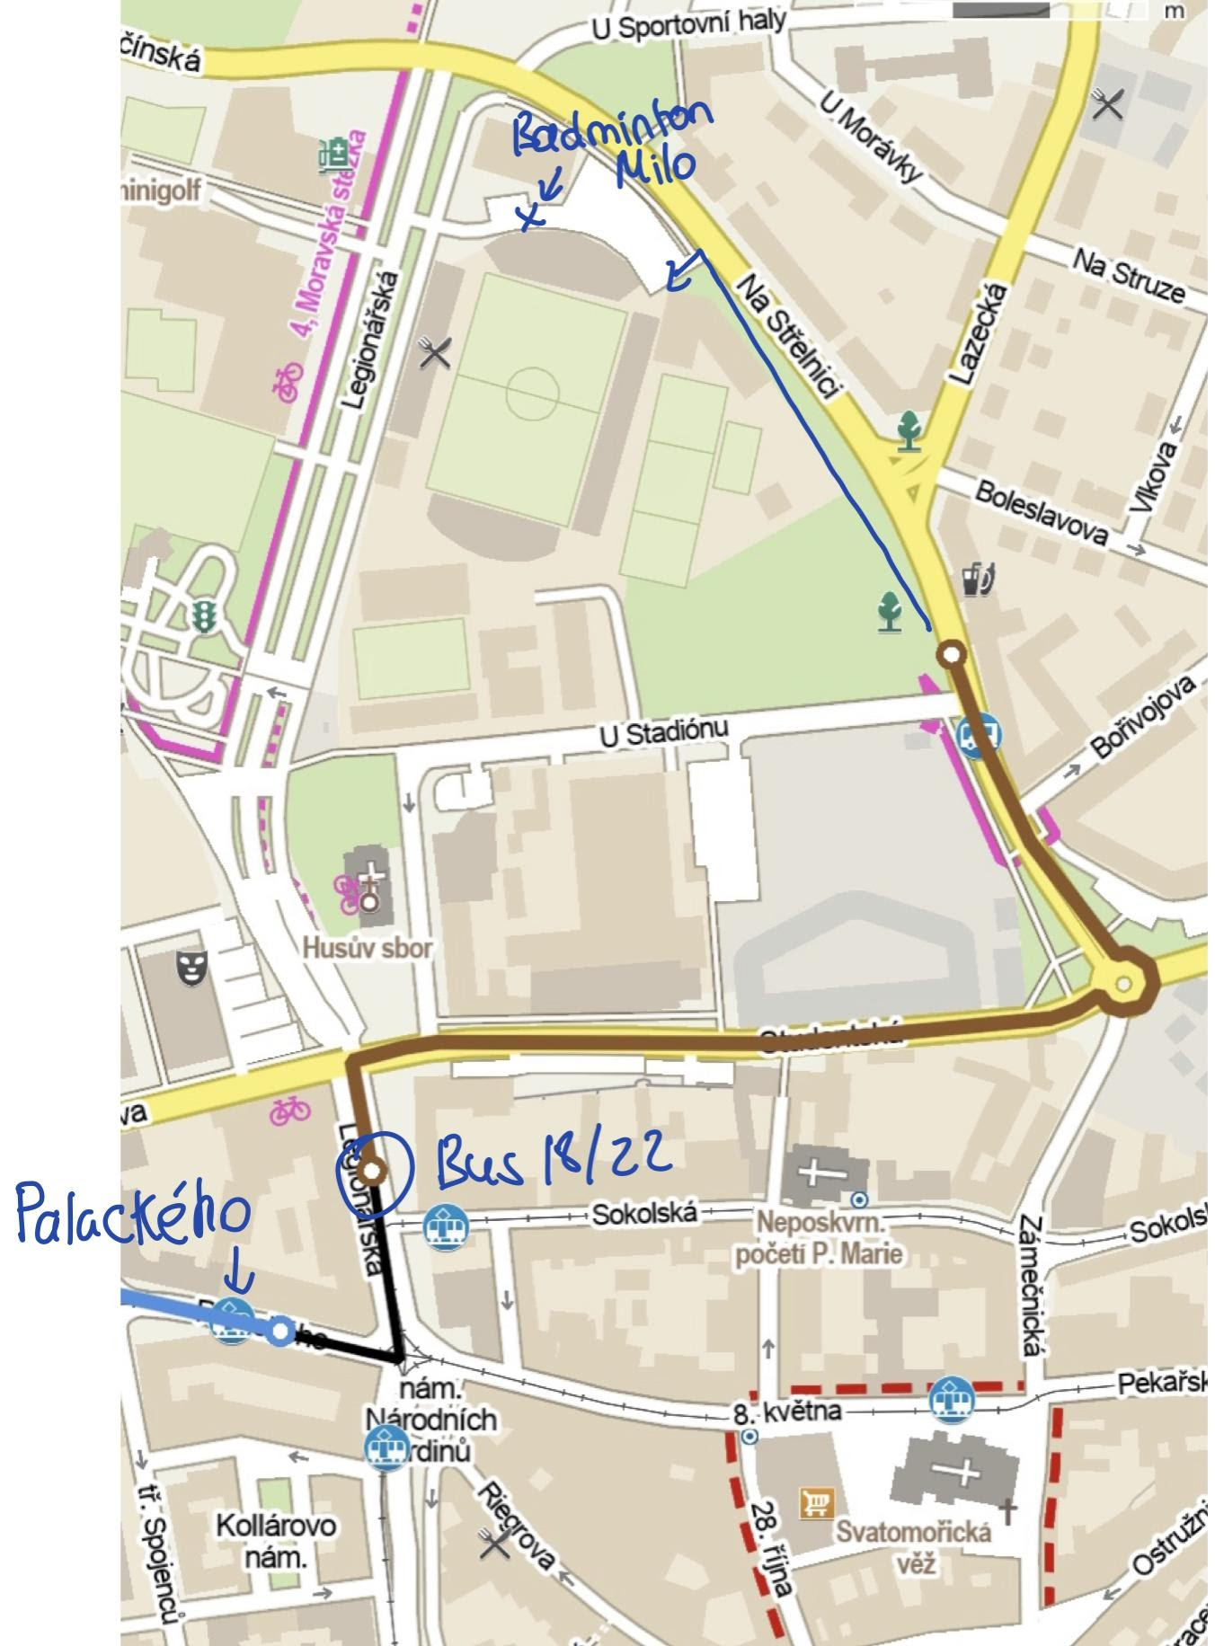
Every Tuesday
2 hours
Doubles and Singles
100kc each
50kc rent a racket
Badminton Milo, Na Střelnici 37, 779 00 Olomouc, Czechia
Neredin Krematorium [7] or [U] —> Bus 18 or 22 —> 6/7 min walk

Slide 15
Play in Neredin
Decide team based on numbers
Group Chat - Whatsapp
11-a-side
Once a week – mid week

Slide 16
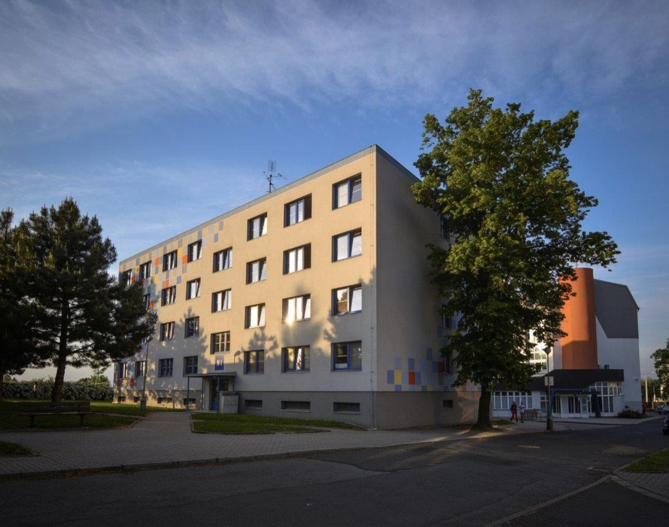
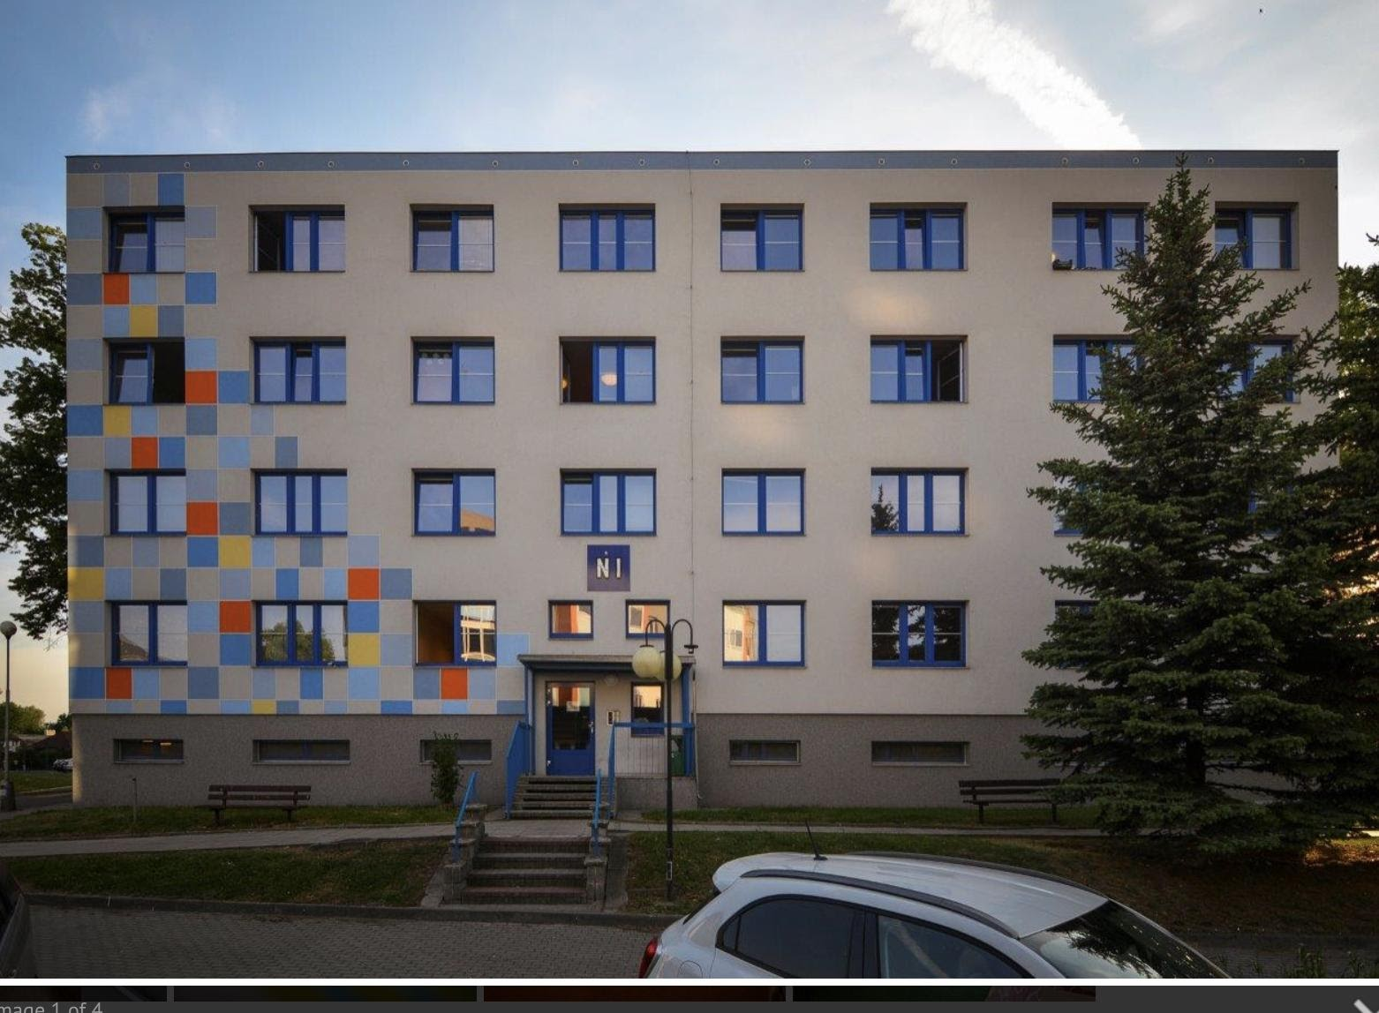
500 Kc per term
Requires ISIC
Basement of N1

Slide 17
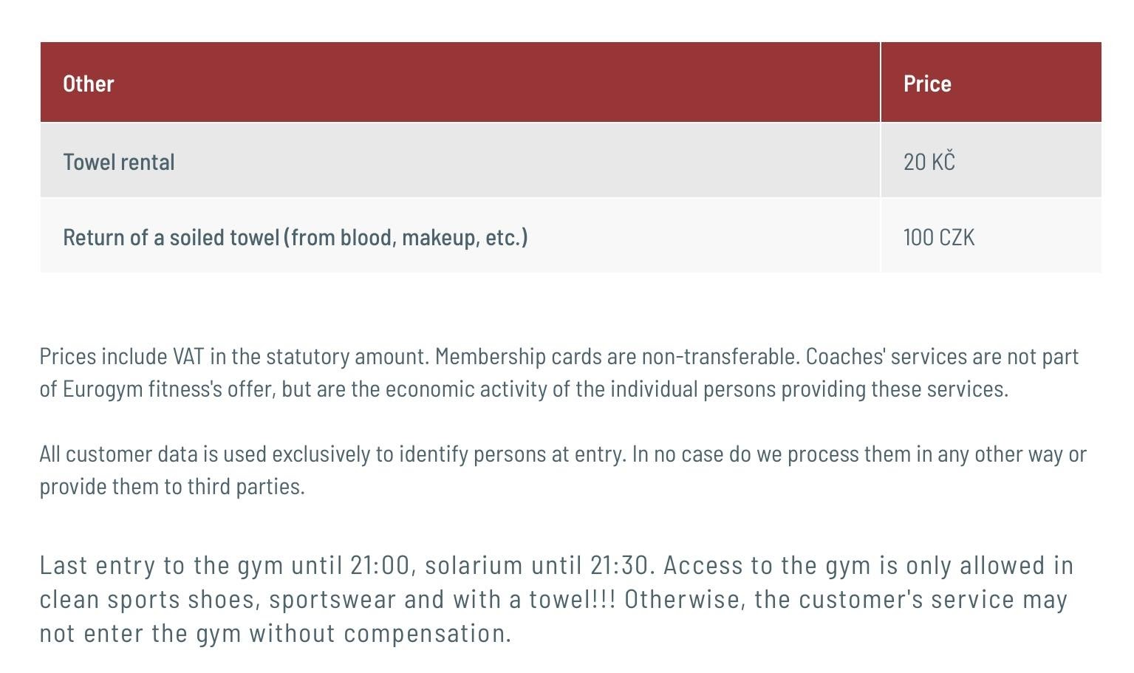
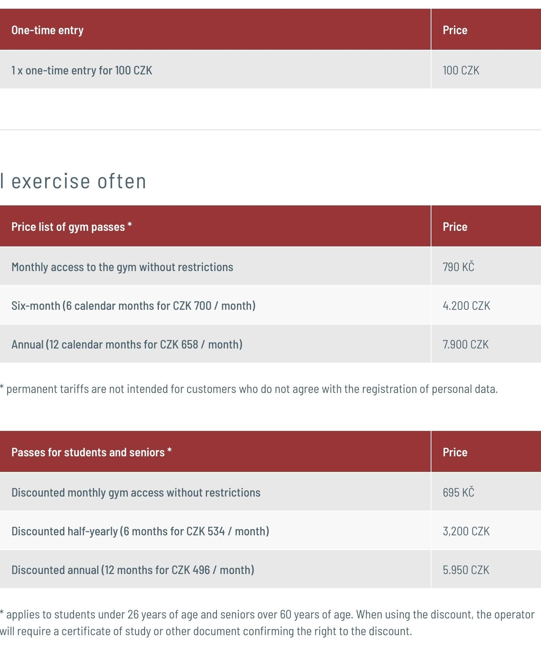
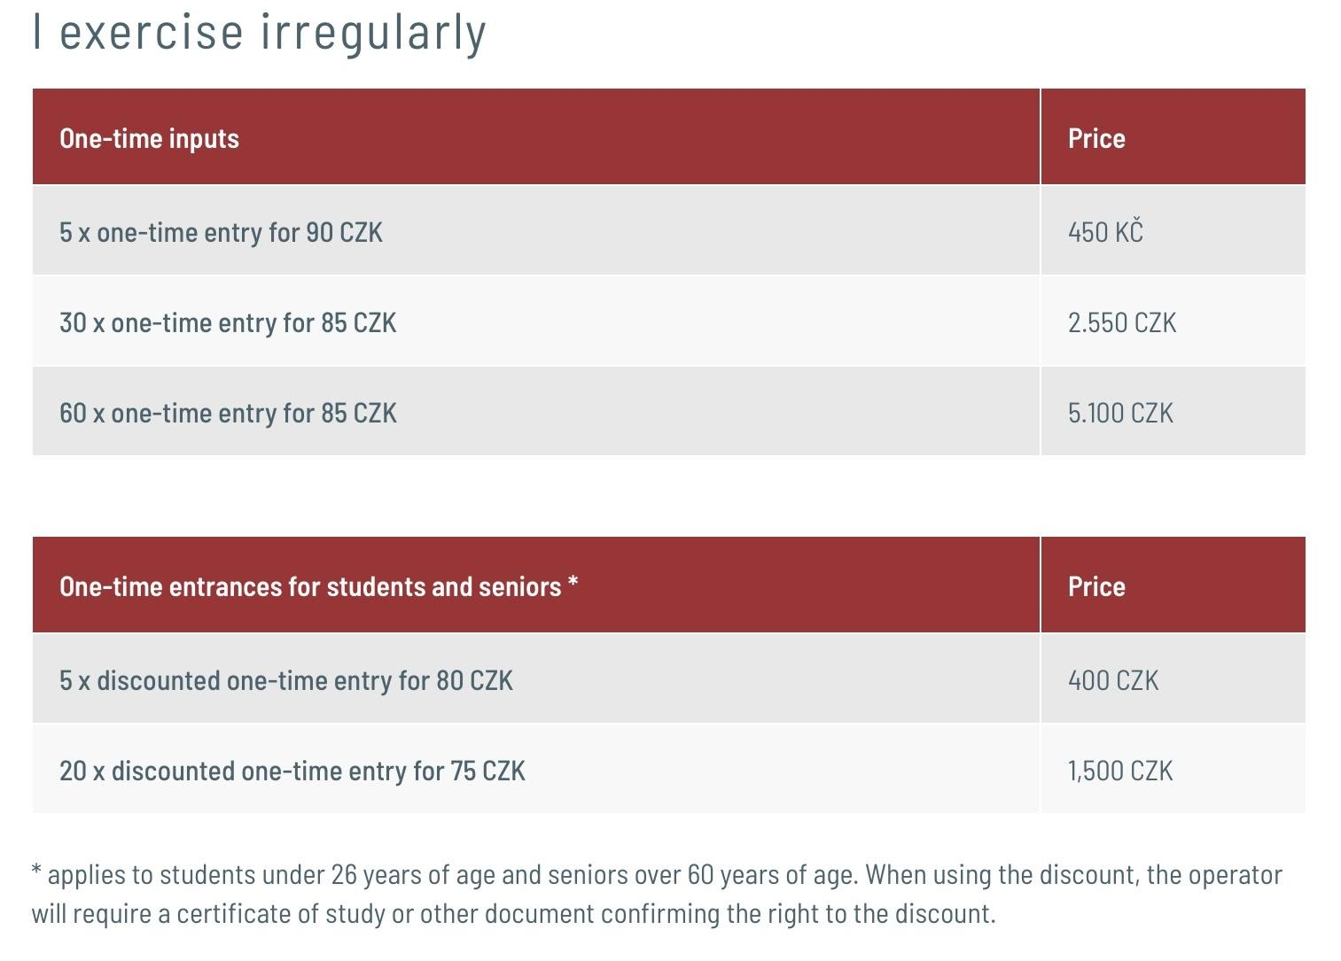

Slide 18
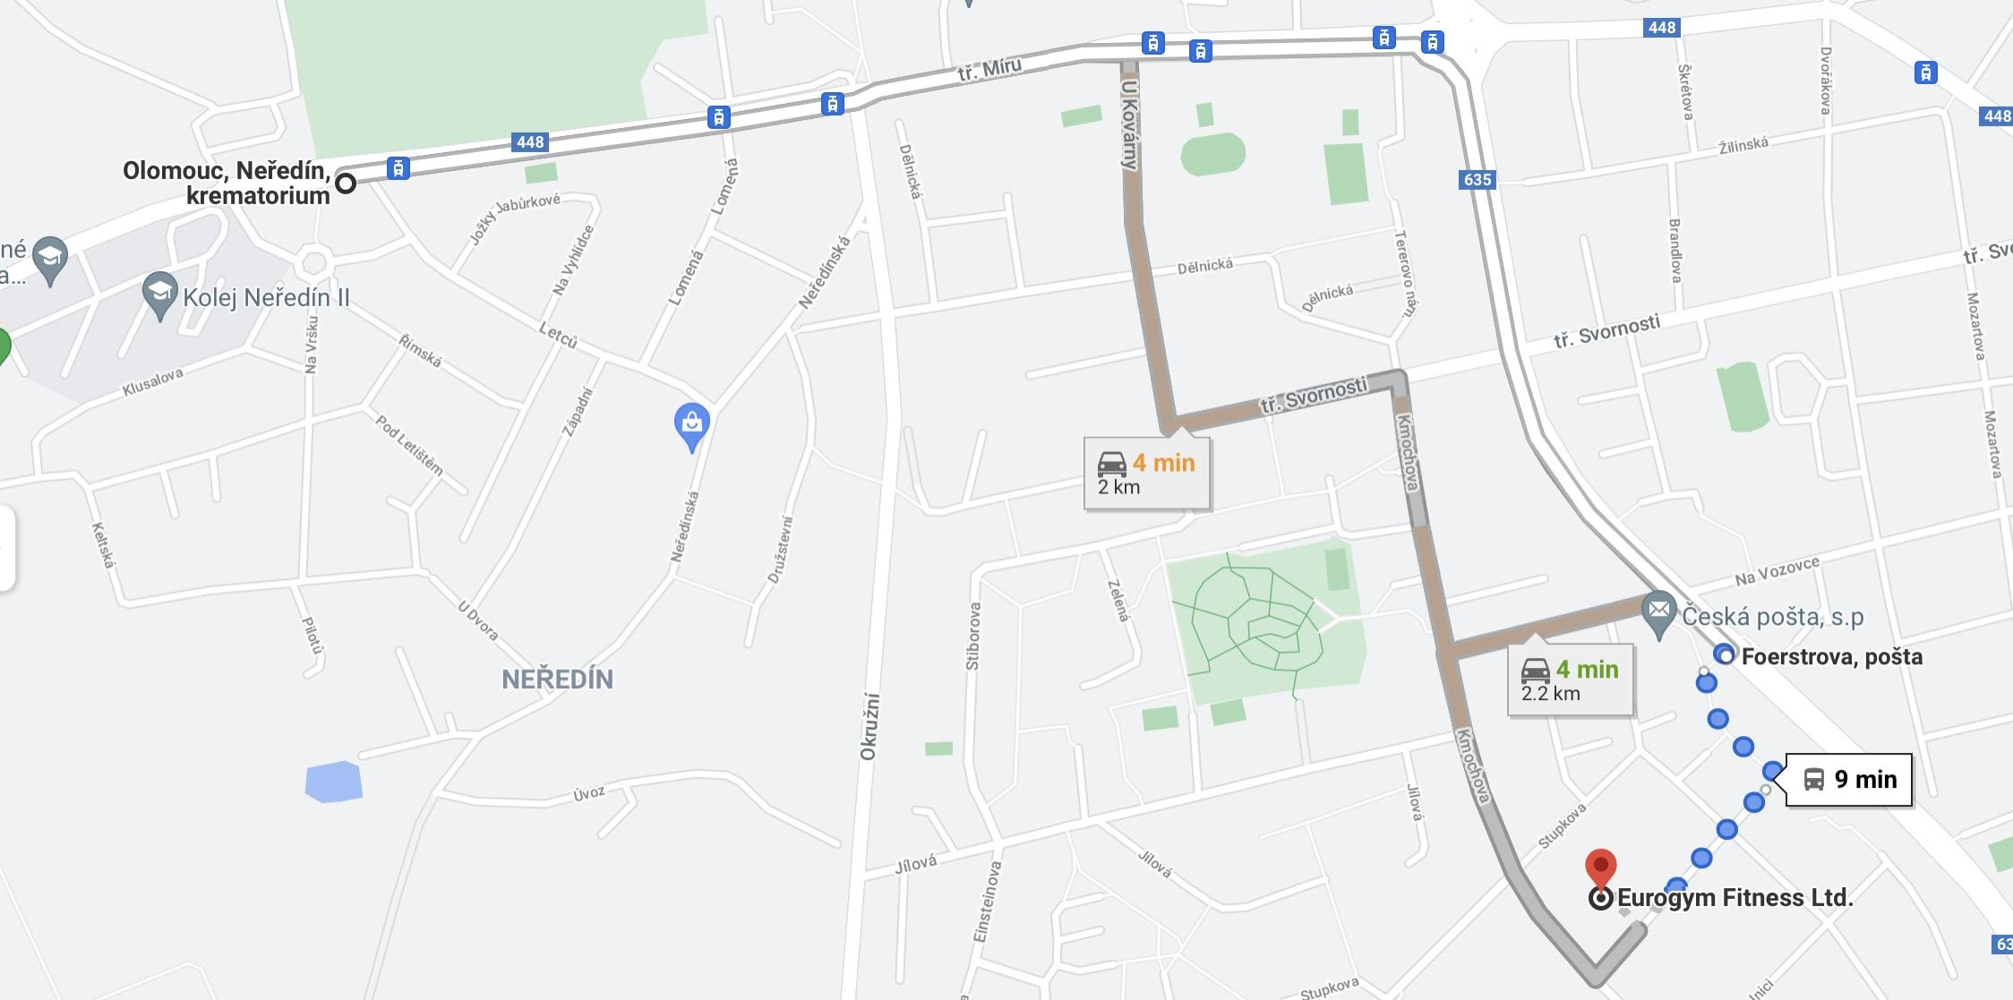
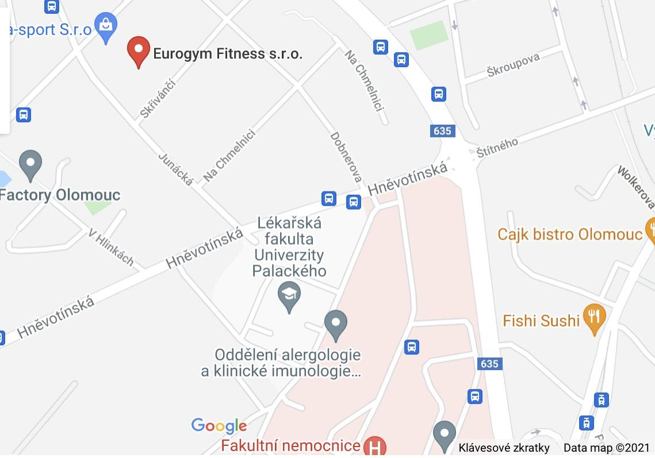
Neredin krematorium [Bus 26] to Foerestrova Posta —> 5 min walk
5 min walk from Uni

Slide 19
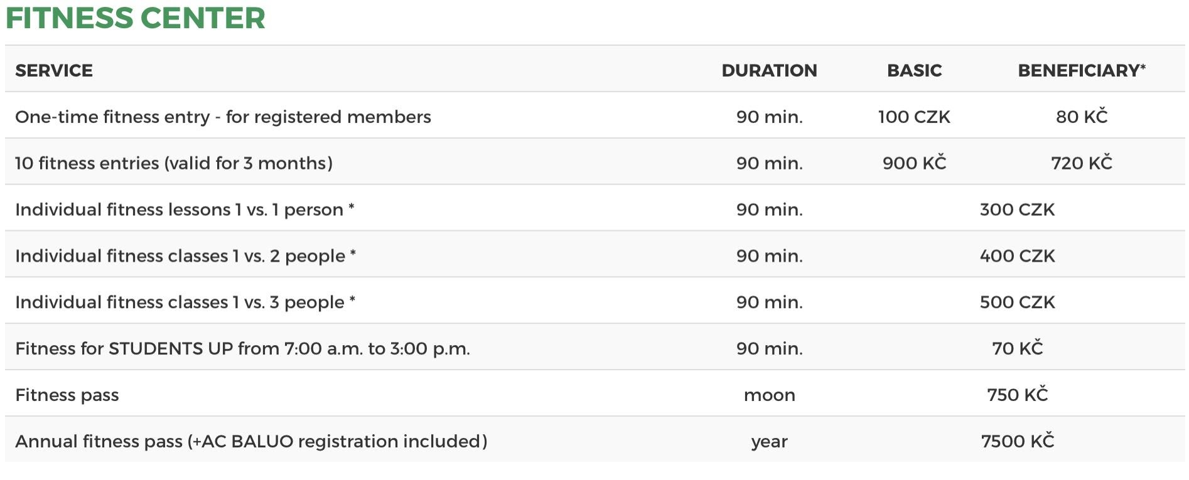
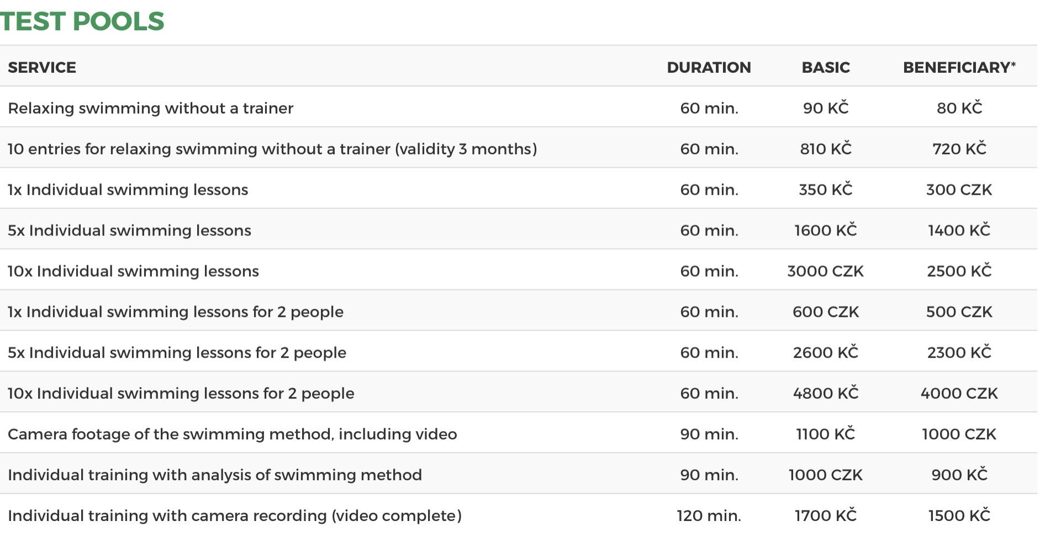

Slide 20
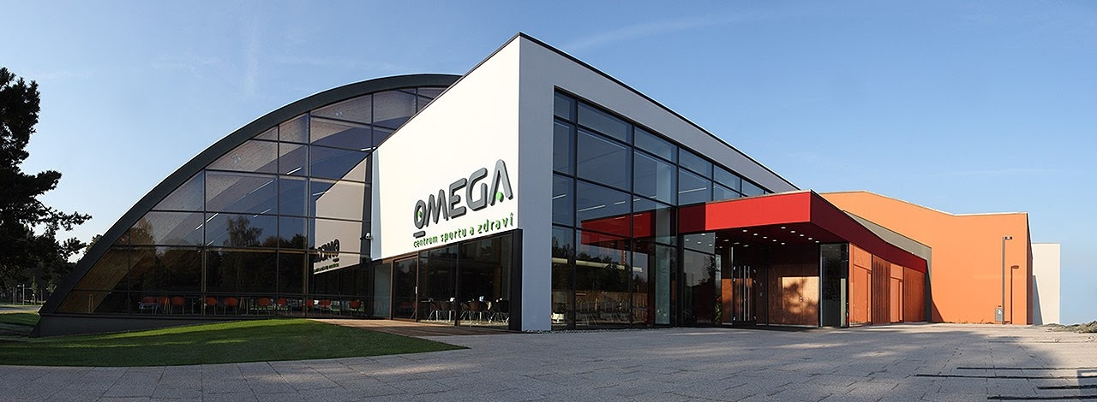
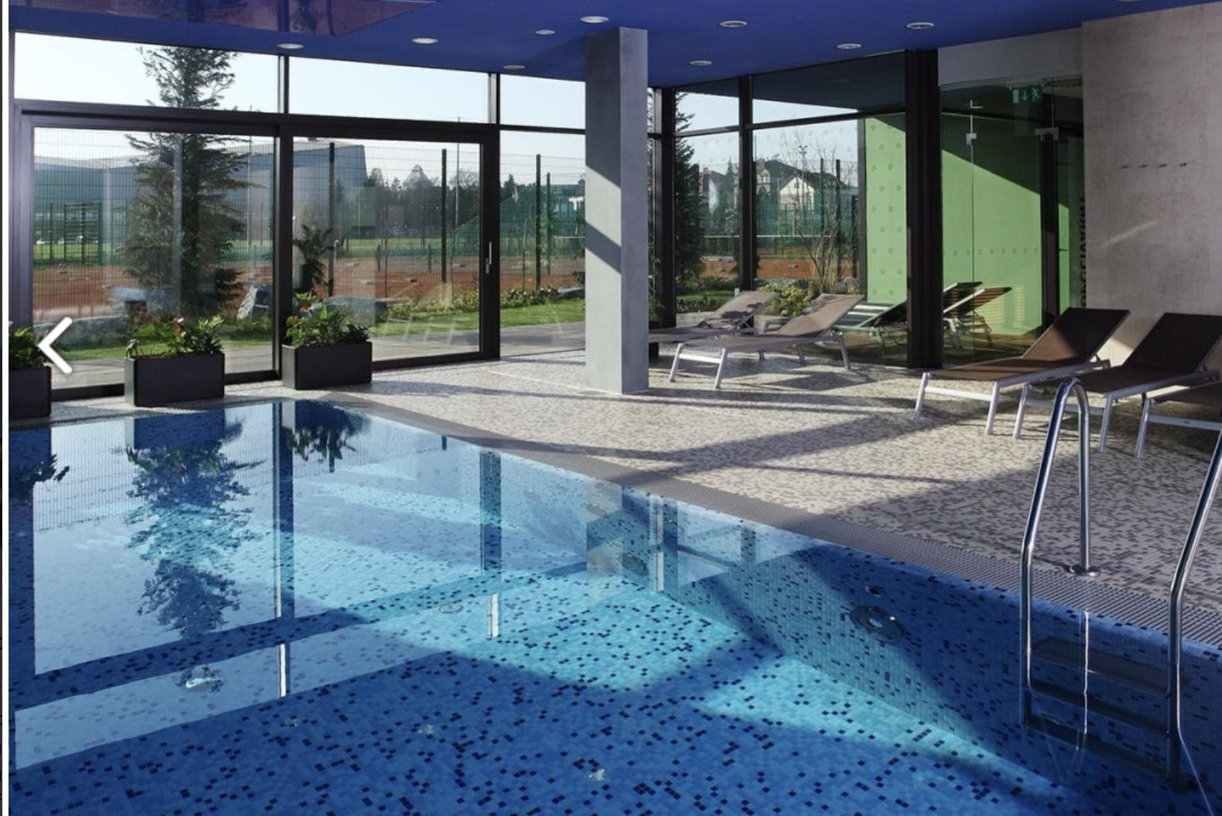
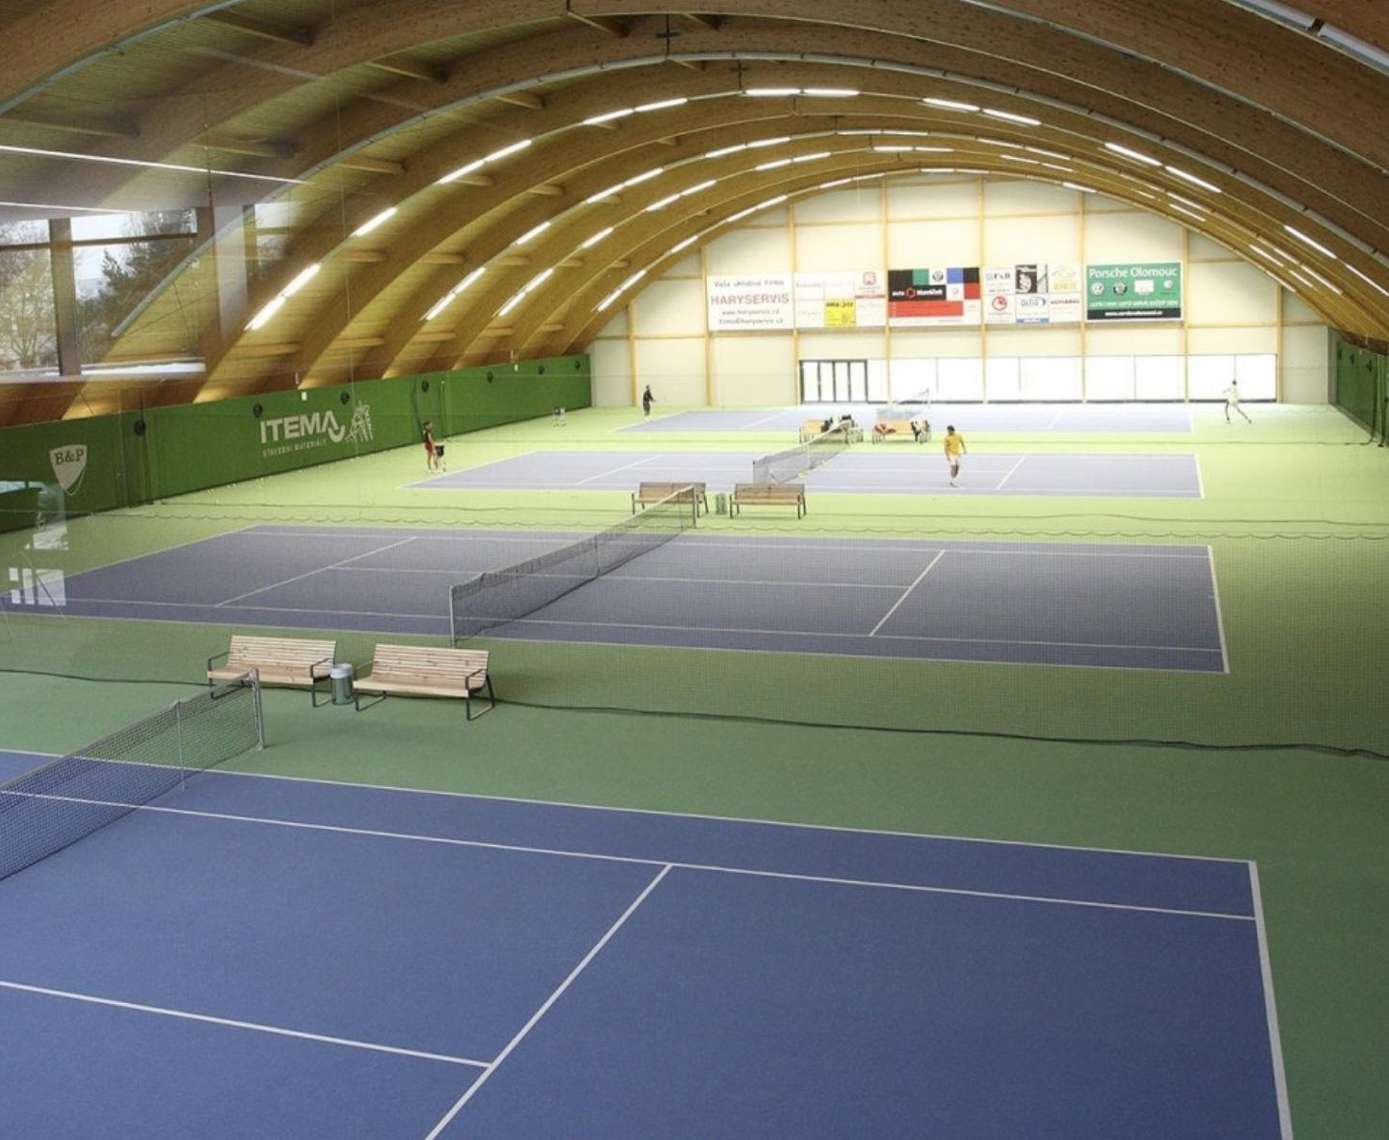
Racket sports (Tennis,[indoor and clay] Badminton)
Fitness - Gym
Fitnesses classes
Massages
Cross-fit
https://www.omegasport.cz

Slide 21
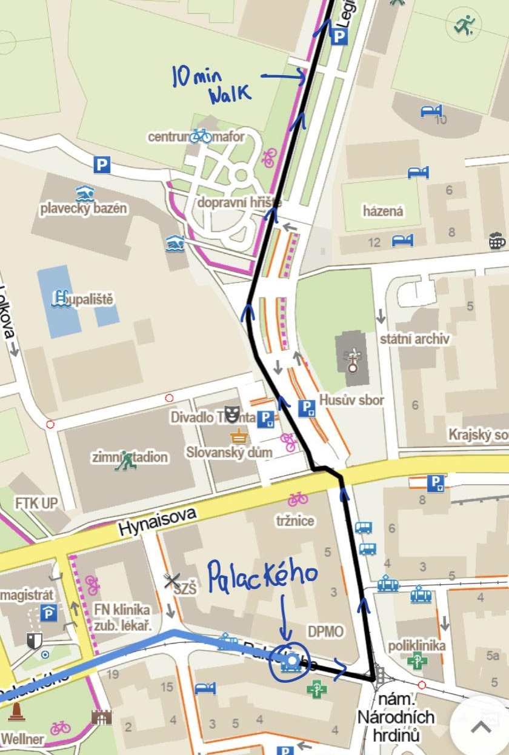
Neredin Krematorium [7] or [U] —> Palackeho —> 10 Min walk to OMEGA sports

Slide 22
LOCATION
U Sportovní haly 38, 779 00 Olomouc
Palacky University Sports Hall
Sports Card
Valid for whole semester
Can do Many sports through the week
https://ascup.upol.cz —> Contains sports program
Archery

Slide 23
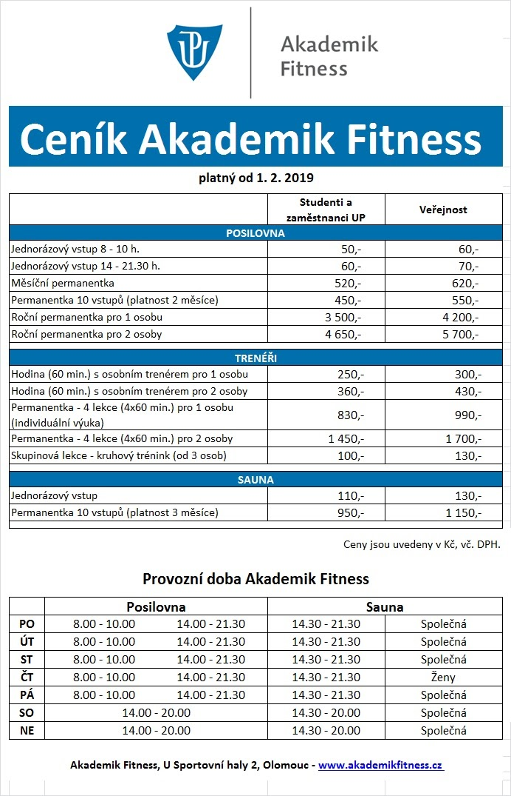
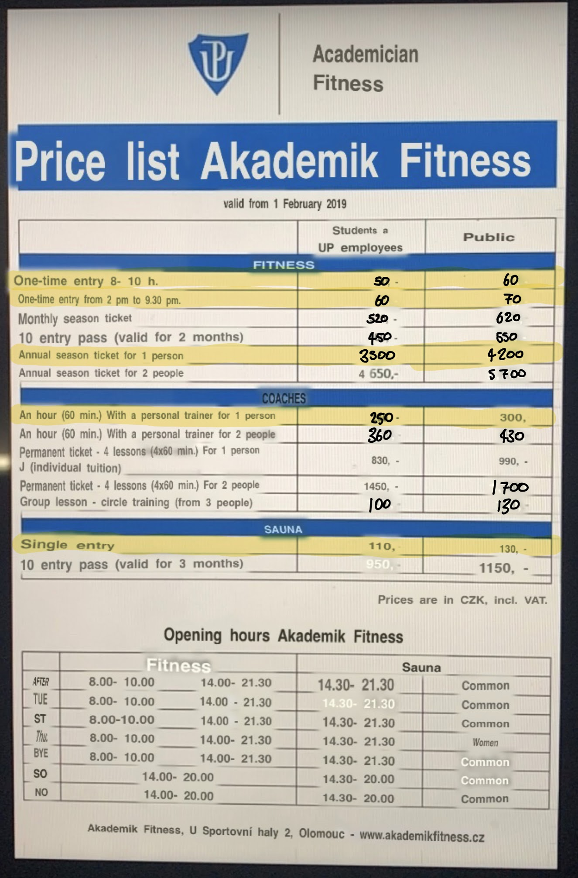

Slide 25
Student Led
Mostly educational:
Clinical Skills (Hamaad 5th yr Medic) - @clinicalskills_soc – instagram / PEPA Clinical Skills Society - FB
Emergency Medicine + Surgical Skills (Saghana 5th yr medic) -
Paediatrics (Evangeline + Prat + Nam 5th yr medics) - @pepapaedsoc – instagram / PEPA Paediatrics Society - FB
Obstetrics and Gynaecology (Myself)
Cardiology (Shayan 6th year medicine)
They will run frequently throughout the year- timetable
Social Media
Notes:
The societies are completely student led

Slide 26
This will be posted on the Facebook page as well as Instagram

Slide 27
Charities: Caritas + PB food bank + Rotary Club
Food bank
Fundraising ideas → come to me if you’re interested/ideas
Recently donated money from a cupcake sale to Bolivia
We are very open to ideas so please don’t hesitate to come forward

Slide 28
Halloween
Diwali Dinner and Bollywood Night
Christmas
Purim
Med and Dent Ball

Slide 29
Magdalin Jerrahrd
+447583164111
@mag.sinthu
Magdalin Jerrahrd

Slide 31
Settling in, adjusting, new environment
Freshers events- PEPA instagram and faceboook pages
Building a home away from home and making friends
Education system, revision plans and exams
The Buddy System
Educational and external stressors and pressure
Extracurricular activities, hobbies and events throughout the year

Slide 32
Myself
PEPA team members
Ms Zlata Pražanová
Ms Jana Osmani
Dr Běla Erdösová
Finally just remember there is no judgement here, we are all ears and there is always someone willing to listen and help.

Slide 33
Mayuri Jeyakumar
+44750881594
mayurijey@gmail.com
@mayuri_jey
Mayuri Jeyakumar

Slide 34
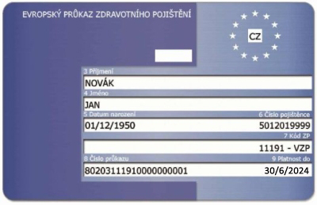
HEALTH INSURANCE
Information for EU CITIZENS – with EHIC
Students must arrange the Czech health insurance document personally in VZP (General Insurance Company/ Jeremenkova 1142, Hodolany, 779 00 Olomouc)
Tuesday | 8AM–2PM
Wednesday | 8AM–2PM
Thursday | 8AM–2PM
Friday | 8AM–2PM
Saturday | Closed
Sunday | Closed
Monday | 8AM–2PM
Only those British students who have had the temporary residence
before the 1st January 2021 can use British health insurance card and document issued on it.
Notes:
Only those British students who have had the temporary residence before the 1st January 2021 can use British health insurance card and document issued on it.

Slide 35
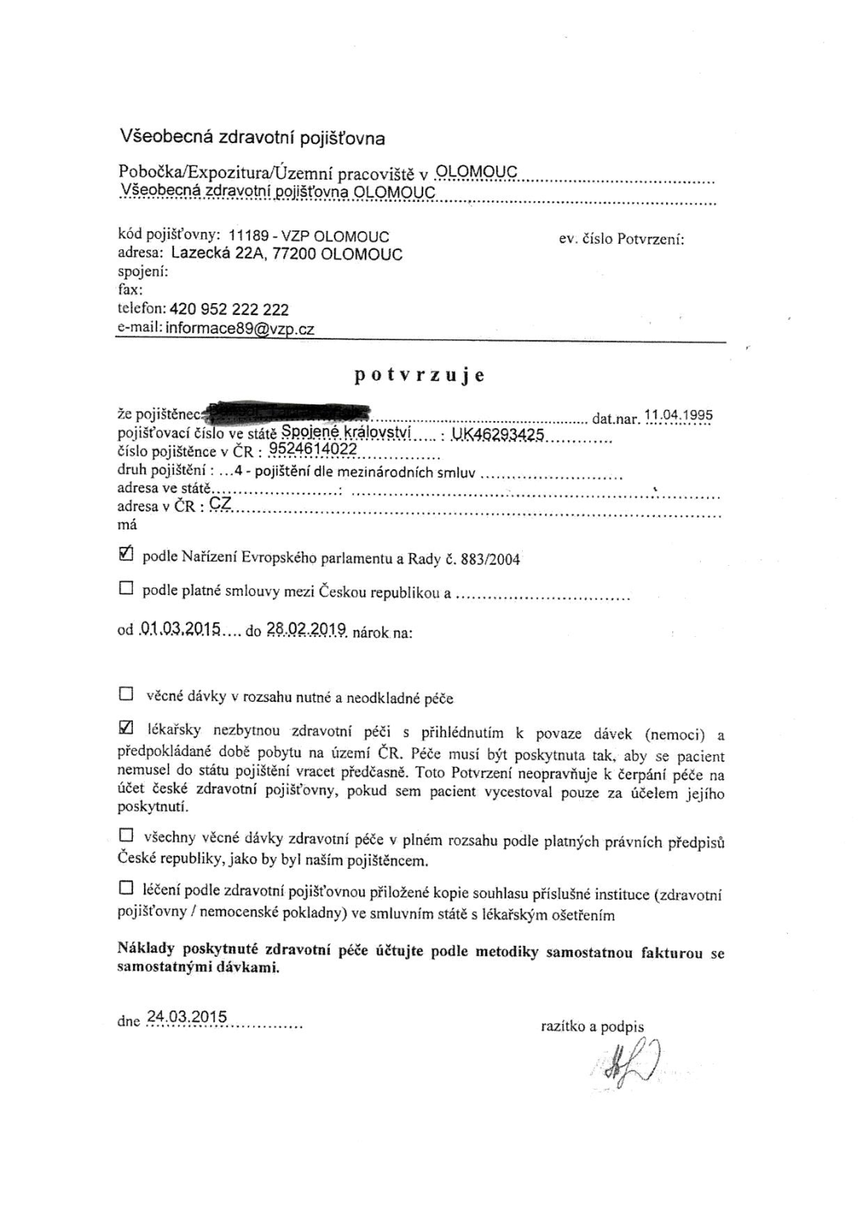
EU Citizens
EHIC
Have this document always with you in case of emergency. You need it anytime you need to see a doctor.
vzp.cz

Slide 36
TAL WILL TAKE YOU THERE FRIDAY 18TH MORNING
COLLECT CONFIRMATION OF STUDIES FROM MS JANA OSMANI BEFOREHAND

Slide 37
1. PASSPORT
2. EHIC
3. CONFIRMATION OF STUDIES

Slide 38
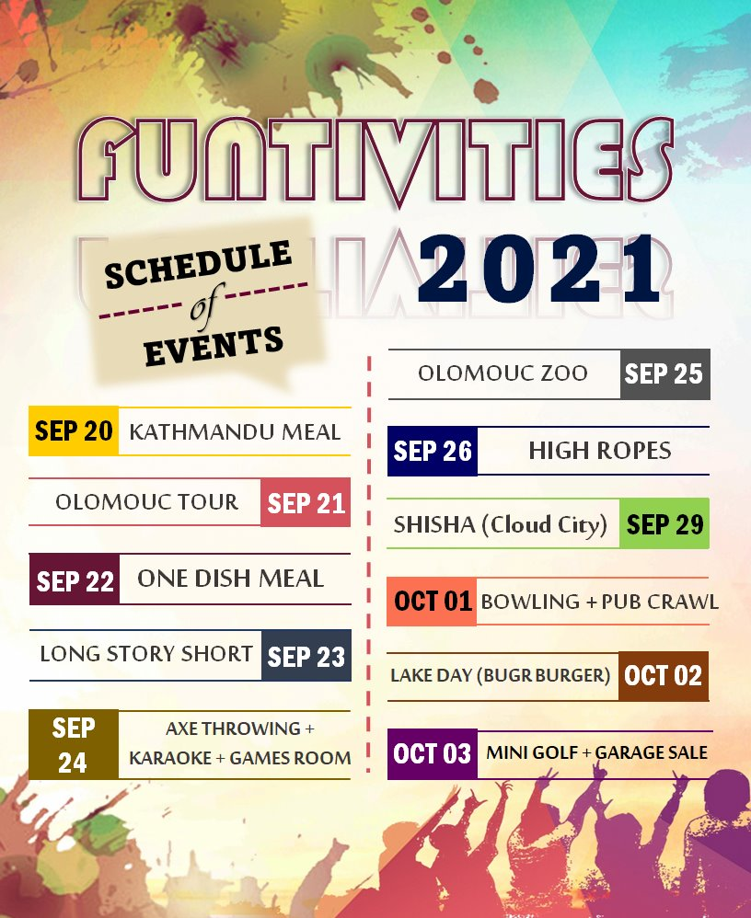

Slide 45
QUESTIONS?

