Slide 1
PALACKÝ UNIVERSITY LIBRARY 12/09/2023

Slide 2
CENTRAL LIBRARY + FACULTY LIBRARIES

Slide 3
MAP OF THE LIBRARY AND THE FACULTY LIBRARIES AROUND THE CITY

Slide 4
Contacts: WEB – www.knihovna.upol.cz/en FACEBOOK - www.facebook.com/knihovnaUP INSTAGRAM - @knihovnaupol Entry to each part of the library is free. Library card = ISIC card (except The British Centre)

Slide 5
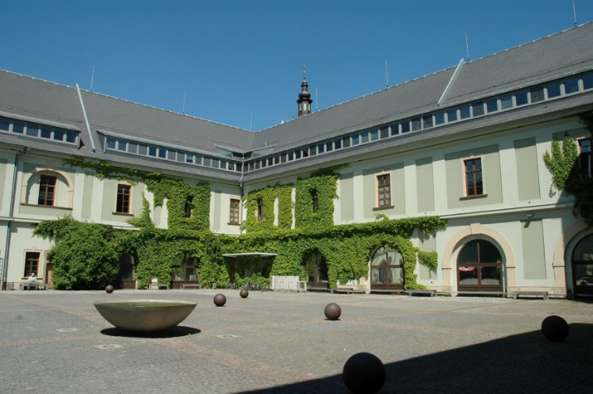
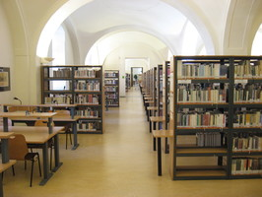
CENTRAL LIBRARY – „Zbrojnice“
OPENING HOURS:
Mon – Thur: 8.00 am – 10.00 pm
Fri: 8.00 am – 7.00 pm
Sat: 9.00 am – 4.00 pm
Night Reading Room – nonstop
The biggest library – near the citycentre
Information Services, Loan Services,Internet in Library, PC rooms, Study rooms, Printing, Copying, Scanning, Bibliographic Information Services, Information Education, Interlibrary Loan Services, Courses, Seminars, Events
You can borrow flash disk, notebook, tablet, umbrella, you can relax with blankets or pillows…

Slide 6
Medical Library
Manager: RNDr. Dana Subova, Ph.D.
E-mail: klf@upol.cz or dana.subova@upol.cz
Telephone number: +420-585 632 951
+420-585 632 965

Slide 7
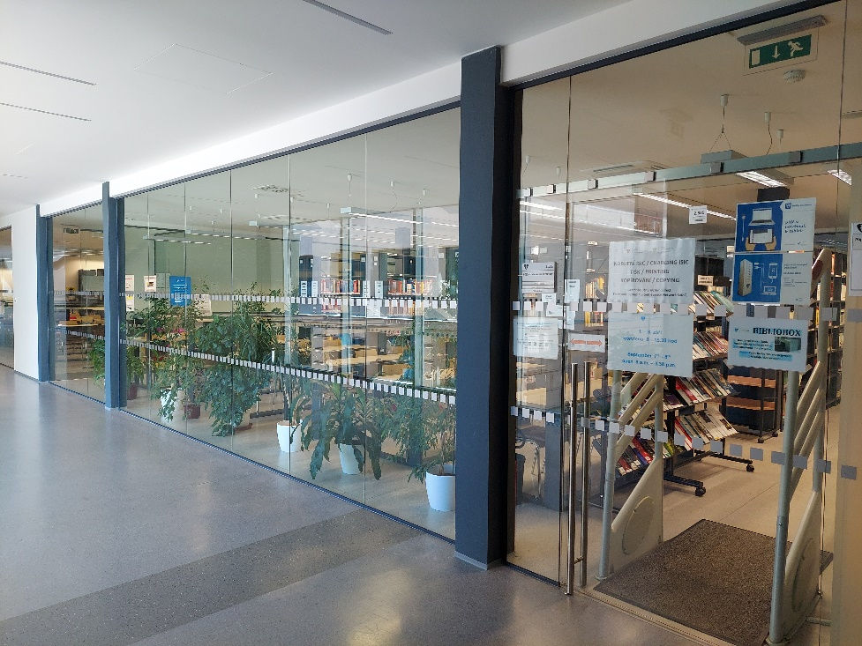
Medical Library Main Web Page

Slide 8
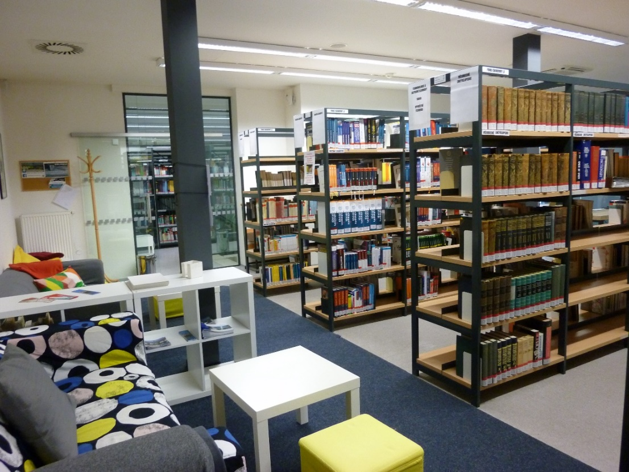
Medical Library Facilities & Services Room Nr. 2.525

Slide 9
Medical Library Facilities & Services
→ The library is located in the “new building” of the Medical Faculty, inside the two glass corridors interconnecting the old and new building.
OPENING HOURS:
Monday – Thursday 8.00 am – 6.00 pm
Friday 8.00 am – 3.30 pm

Slide 10
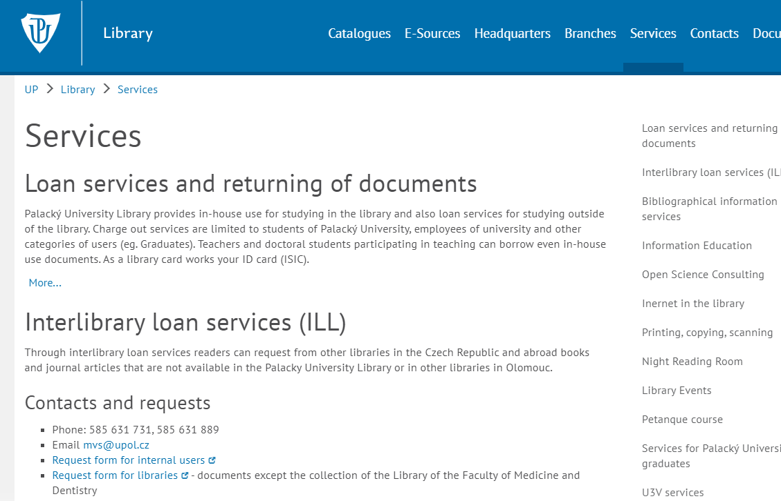
Medical Library Facilities & Services
https://www.knihovna.upol.cz/en/services/
Loan services (max. 15 loans per student), medical books & e-books
Rich collection of Czech and international medical journals, print and e-versions
Study rooms, relaxing corners
Computers, Internet, free Wifi
Access to electronic information resources
Information services, consultations, literature search services
Copying, printing – Your ISIC cards can be pre-charged by the staff of the Medical Library
Scanner

Slide 11
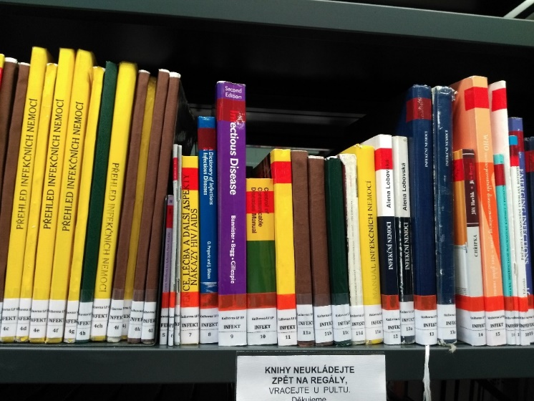
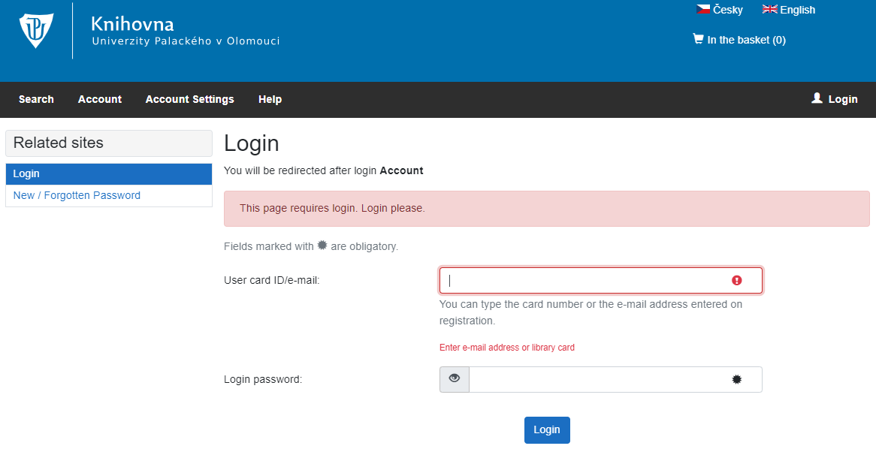
Medical Library Facilities & Services
Loan services (english medical books, textbooks, databases, foreign journals…)
Loan period is 30 days
You can borrow max. 15 books
You can prolong your loans 3x
→ By the telephone, e-mail, personaly in the library or through your login in the union catalogue
→ You can prolong if there is no reservation or no fine for the book!

Slide 12
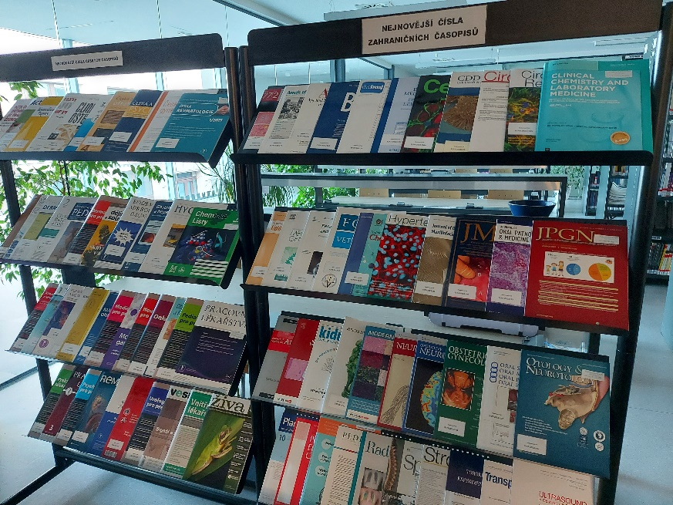
Medical Library Facilities & Services
´
Overdue fine: 2.- CZK per day per 1 book!
Reference books are In-library use only – marked with a red stripe. It´s possible to borrow them also overnight until the next morning 9.00 am.

Slide 13
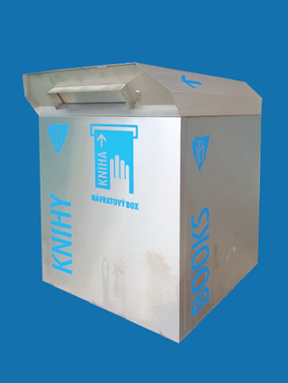
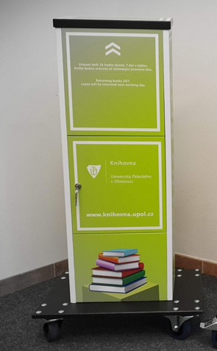
Medical Library Facilities & Services
Returning books →
In the Medical Library
In the central library + in all faculty libraries
Bibliobox – it is located in front of the faculty
You can return your books in the „bibliobox“ 24 hours a day, 7 days a week.

Slide 14
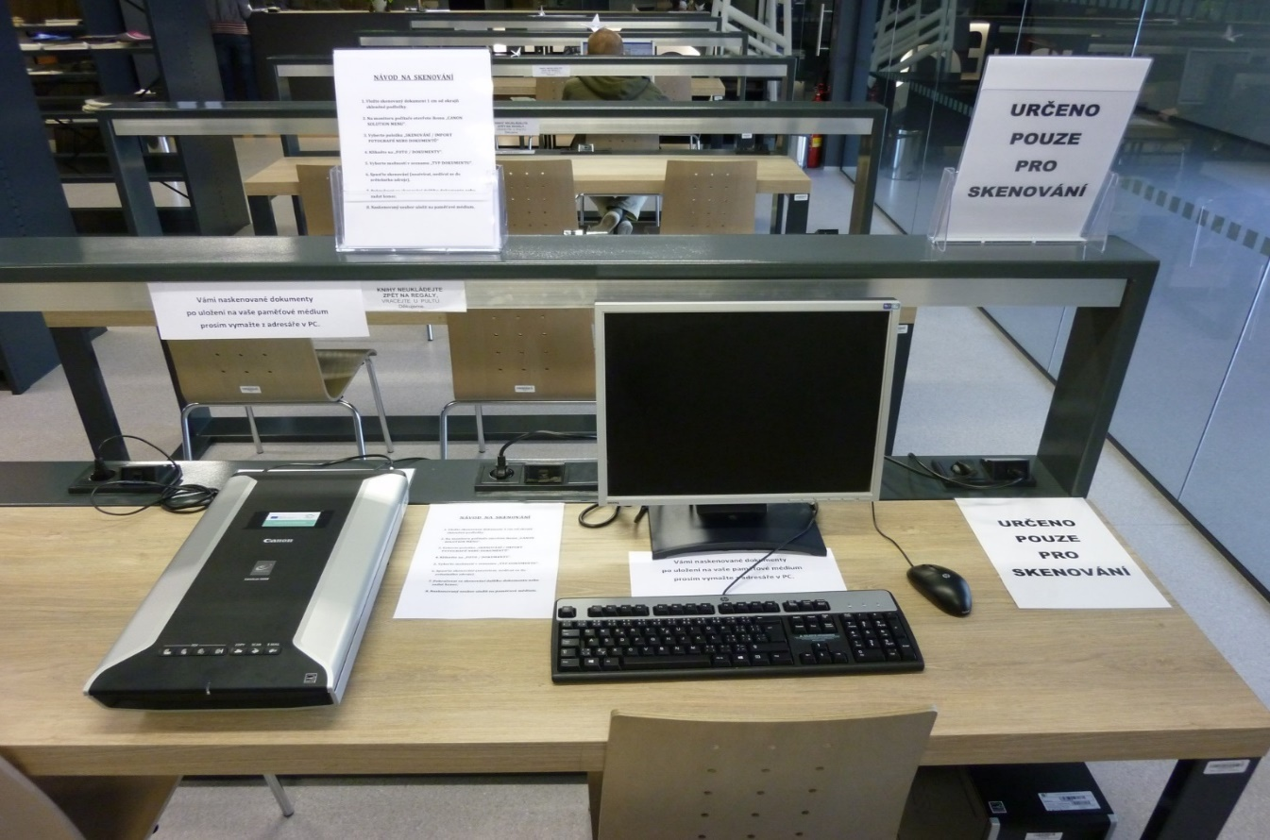
Medical Library Facilities & Services
Self-Service Scanning

Slide 15
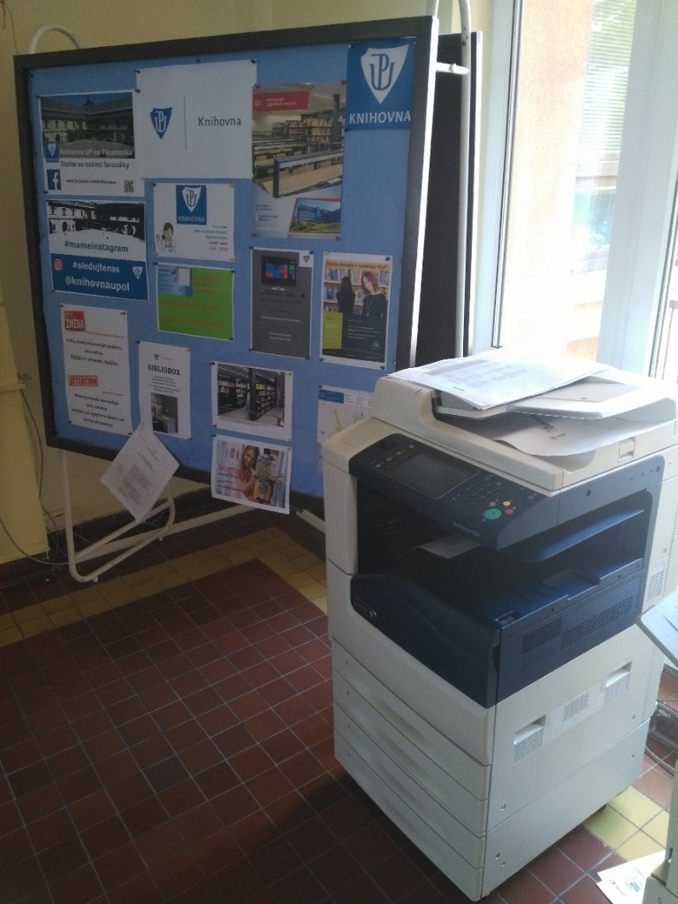
Medical Library Facilities & Services
Printing and Copying
All library branches are equipped with self-service copying and printing machines.
The copying is a paid service, you use your ISIC card with a pre-paid credit.
The cards can be pre-charged in Medical Library.
Instructions and price-lists → Library website or by the copying machines.
Print → PC
login = Portal ID + password
http://safeq.upol.cz/

Slide 16
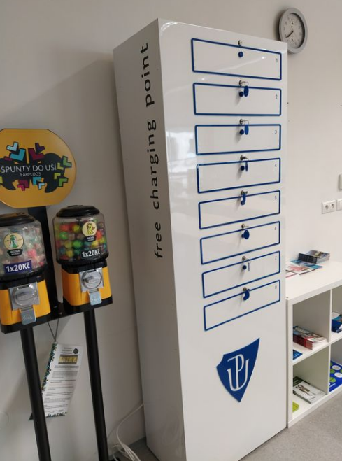
Free charging point Rooms Nr. 2.525 and Nr. 2.542

Slide 17
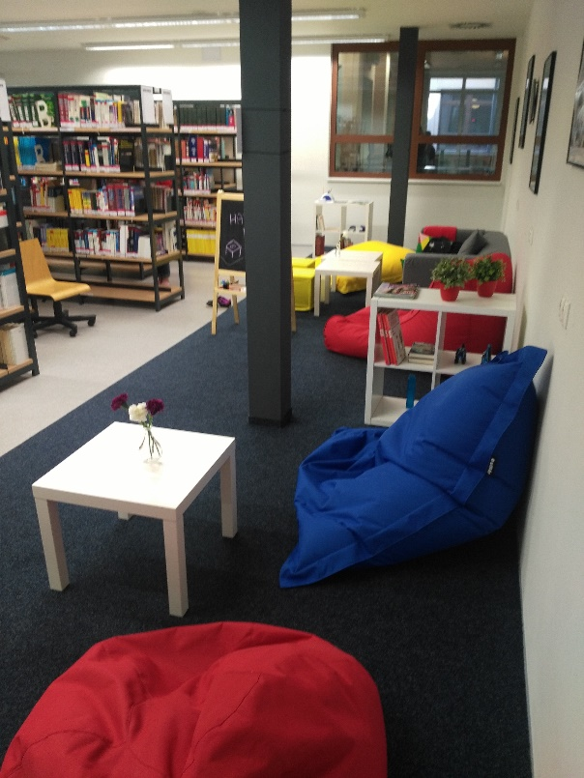
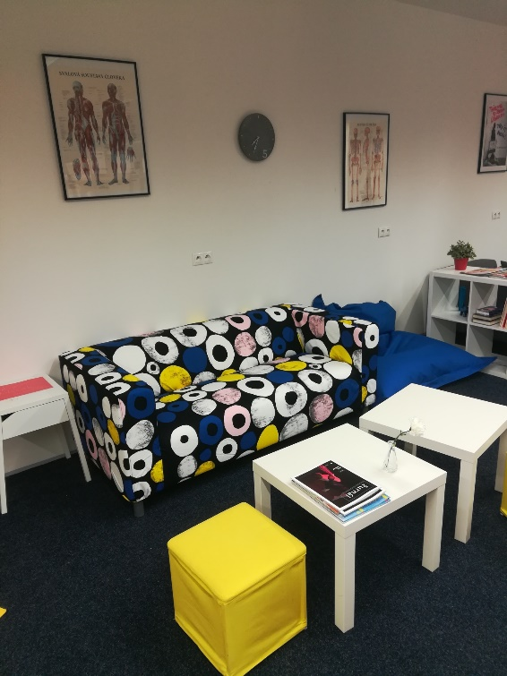
Medical Library First relaxation corner

Slide 18
Laptop or tablet
Forget your laptop or tablet?
You can borrow it
in the library!
In-library use only

Slide 19
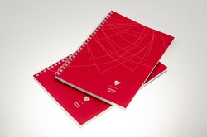
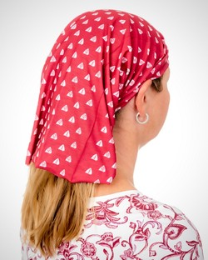
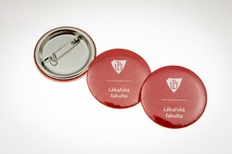
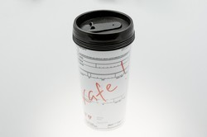
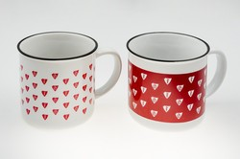
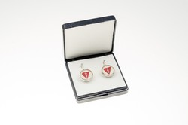
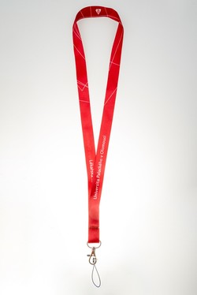
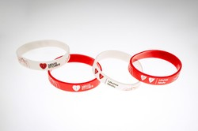
Faculty´s souvenirs
Memorabilia
Fancy a Faculty of Medicine and Dentistry souvenir?

Slide 20
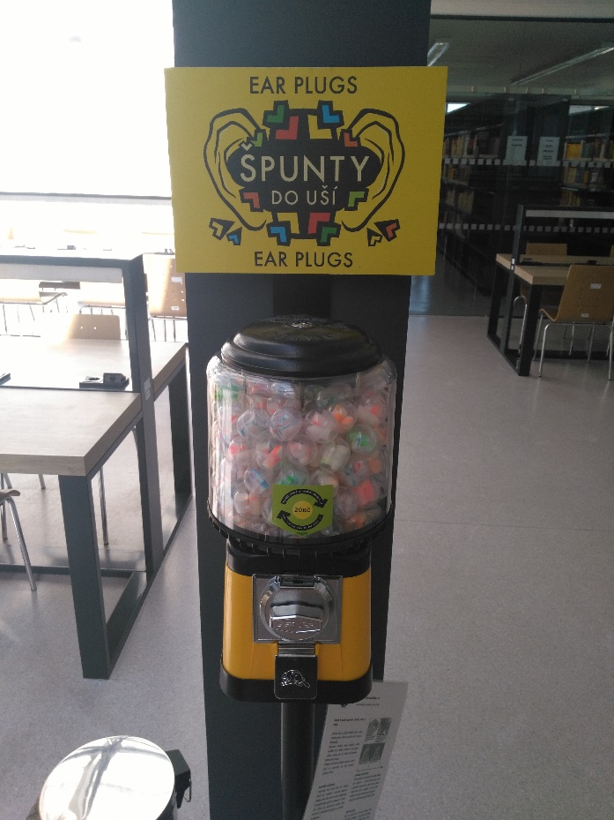
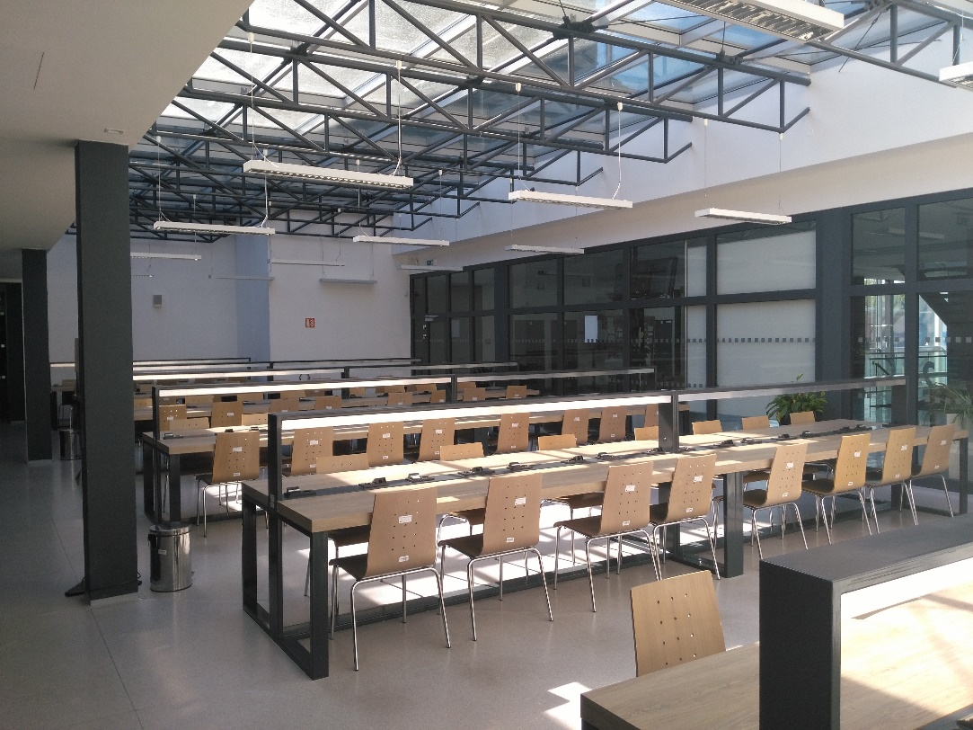
Where can you study or use a computer?
Silent Study Room – New Building „Šantavého sál“
UNDER REPAIR

Slide 21
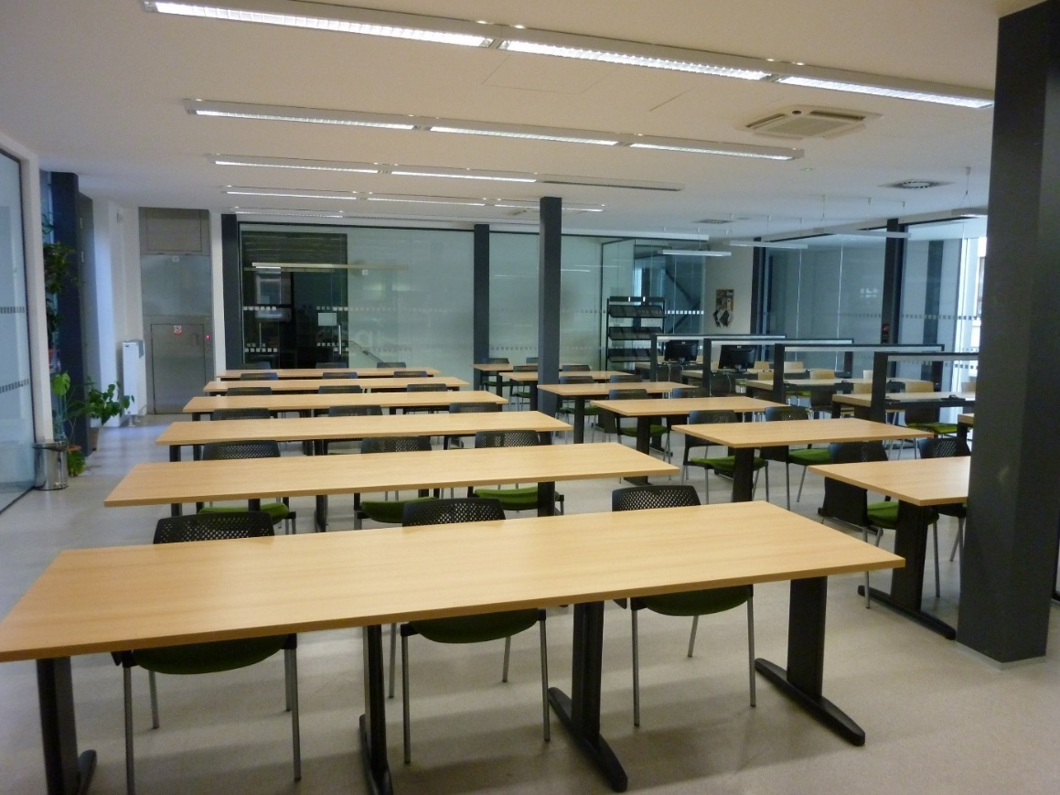
Study Room Room Nr. 2.542

Slide 22
Where can you study or use a computer? Room Nr. 2.542
Study Room
→ located inside the second corridor opposite the Medical Library
OPENING HOURS:
Monday – Thursday 8.00 am – 6.00 pm
Friday 8.00 am – 3.30 pm
→ so it is open there same as in the Medical Library ☺

Slide 23
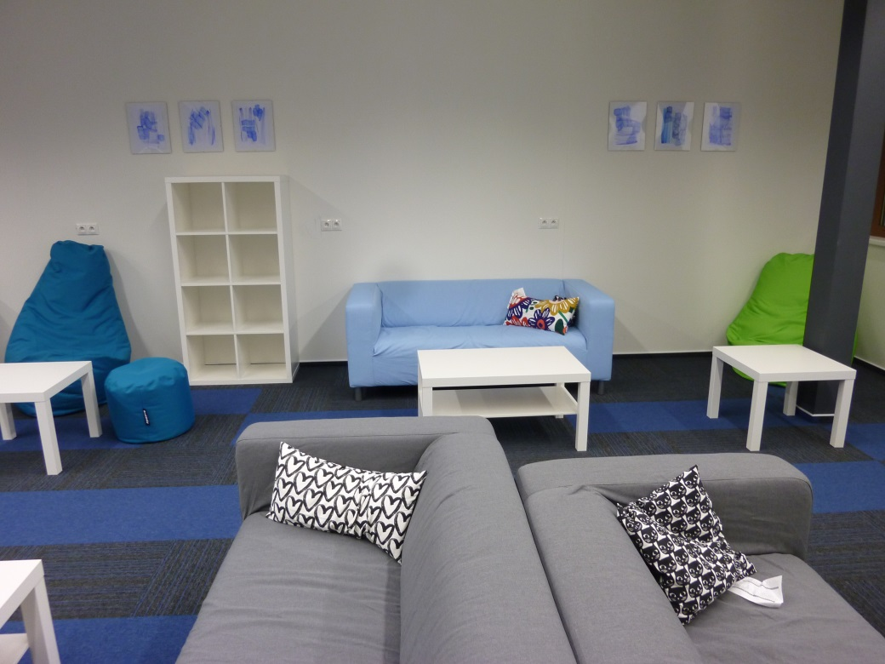
Medical Library Second relaxation corner

Slide 24
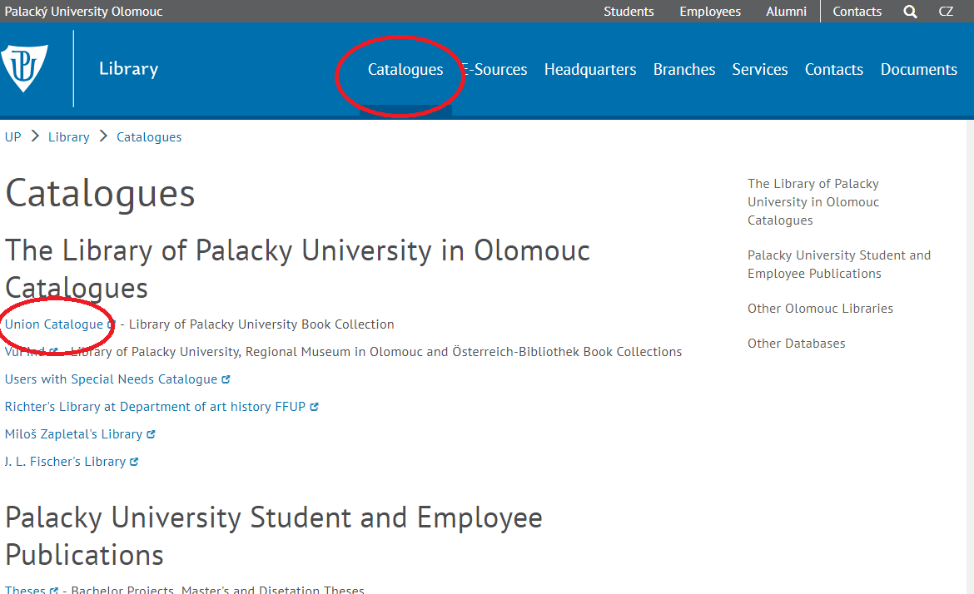
Searching literature → UNION CATALOGUE
Palacky University Book Collection

Slide 25
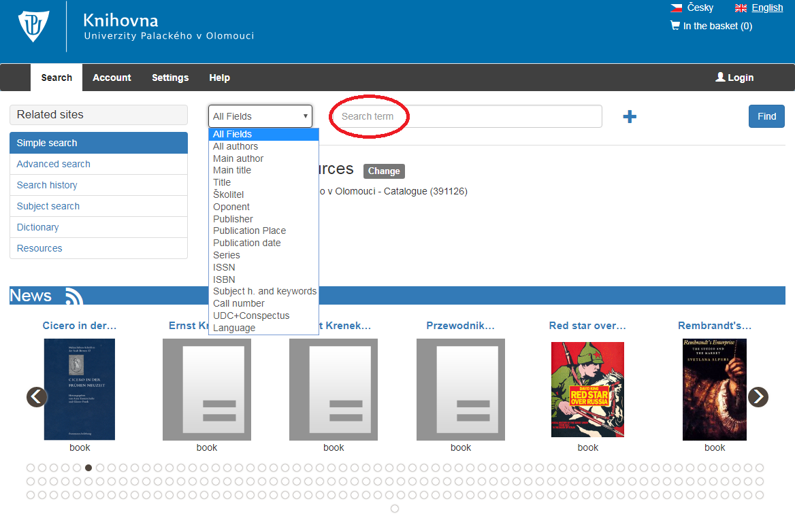
UNION CATALOGUE
Library of Palacký University Book Collection - search

Slide 26
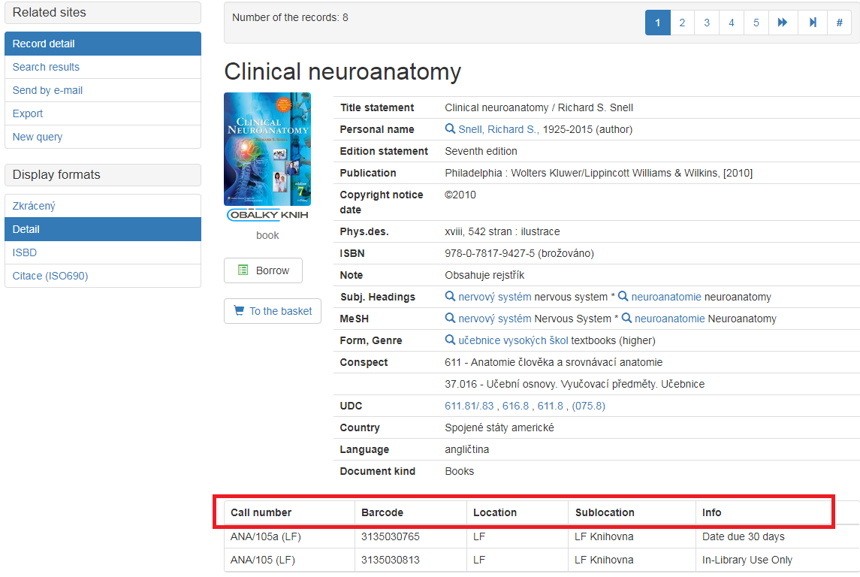
UNION CATALOGUE
Library of Palacký University Book Collection –
An example of a search result →

Slide 27
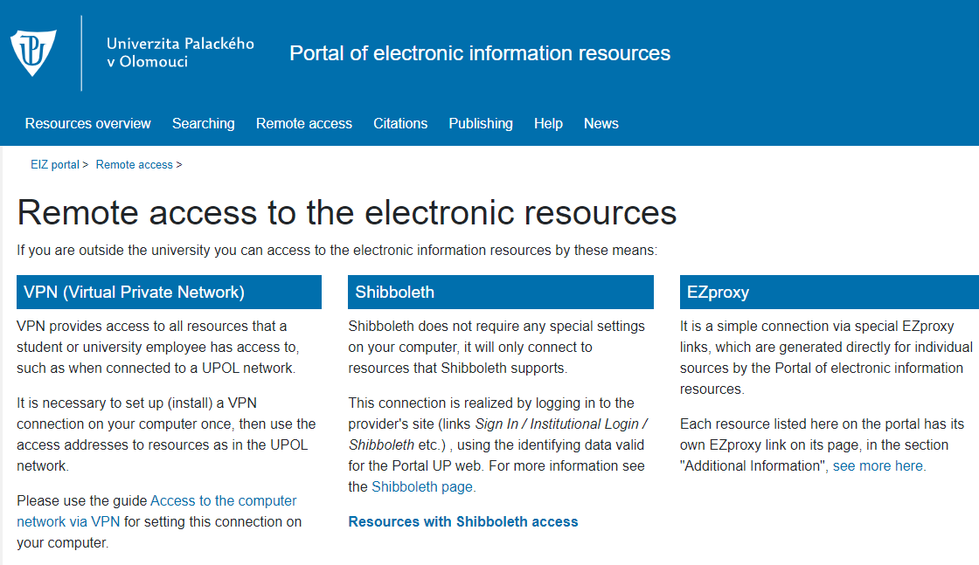
Portal of electronic information resources Ezdroje.upol.cz
Electronic information resources provide access to information used in the science and research.
This portal offers primarily the licensed resources.
Resources are available either from any place at the Palacký University or only within a particular fakulty or via remote access.

Slide 28
How you can join the Palacký University computer network?
2 types of networks:
1. EDUROAM network
Instructions for use can be found at:
https://wiki.upol.cz/upwiki/Pristup_k_pocitacove_siti/en → setup instructions for Android, IOS, Windows, Mac…
Username (uživatelské jméno) = your portal ID
Password (heslo) = a code assigned by the University
2. UPOL WIFI network
You can find currently valid password after logging in to http://portal.upol.cz in the section Help/Helpdesk.
WIFI is not available for all databases. (license)

Slide 29
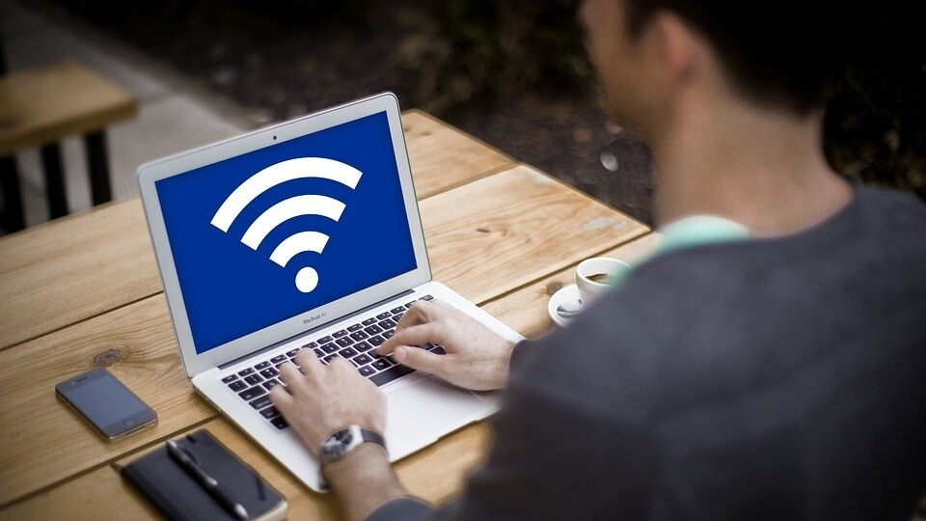
If you face same troubles with conection…
Computer Network Administration
VPN, WI-FI → Troubleshooting
Staff:
Tomáš Kopečný, Dis.
tomas.kopecny@upol.cz
585 632 958
Room: old building, door no. 1.015

Slide 30
Thank you for attention and see you in the library!

